Slide 1


Your Software Testing QnA
Pramod Dutta
Discussion About Career, Job and Many More.

Slide 2
Agenda
Discussion in QnA on Comments
Question about Job, Career on Software tester
Mindset Of QA
Freelancing QA Discussions
Increase CTC Tips
Job Opening Fresher, (2+ Automation)

Slide 3
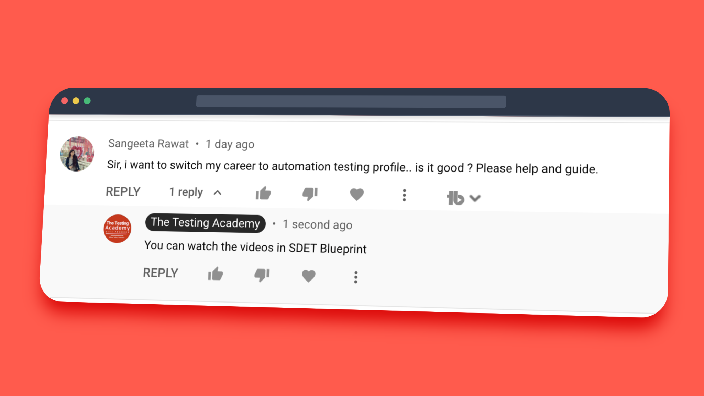
Watch - https://sdet.live/switch

Slide 4
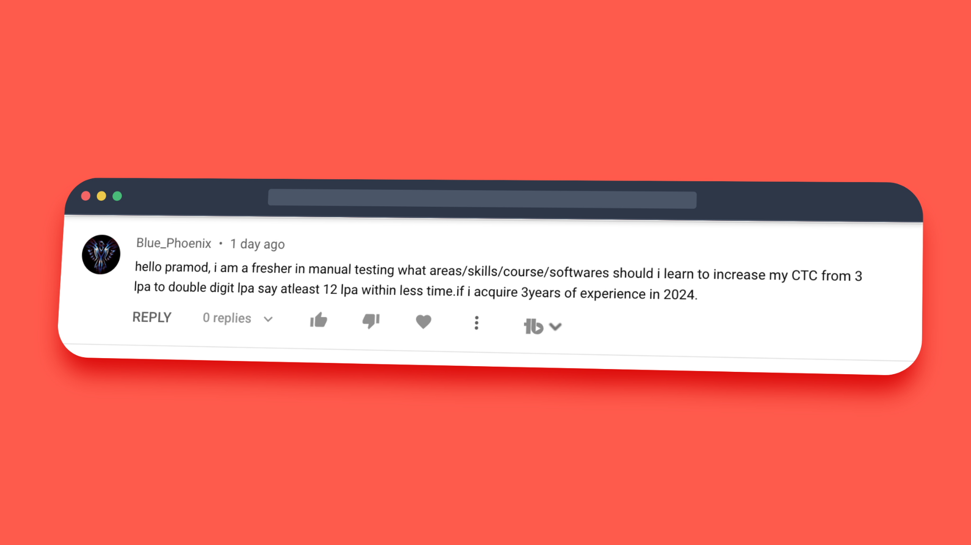
Watch - https://sdet.live/switch

Slide 5
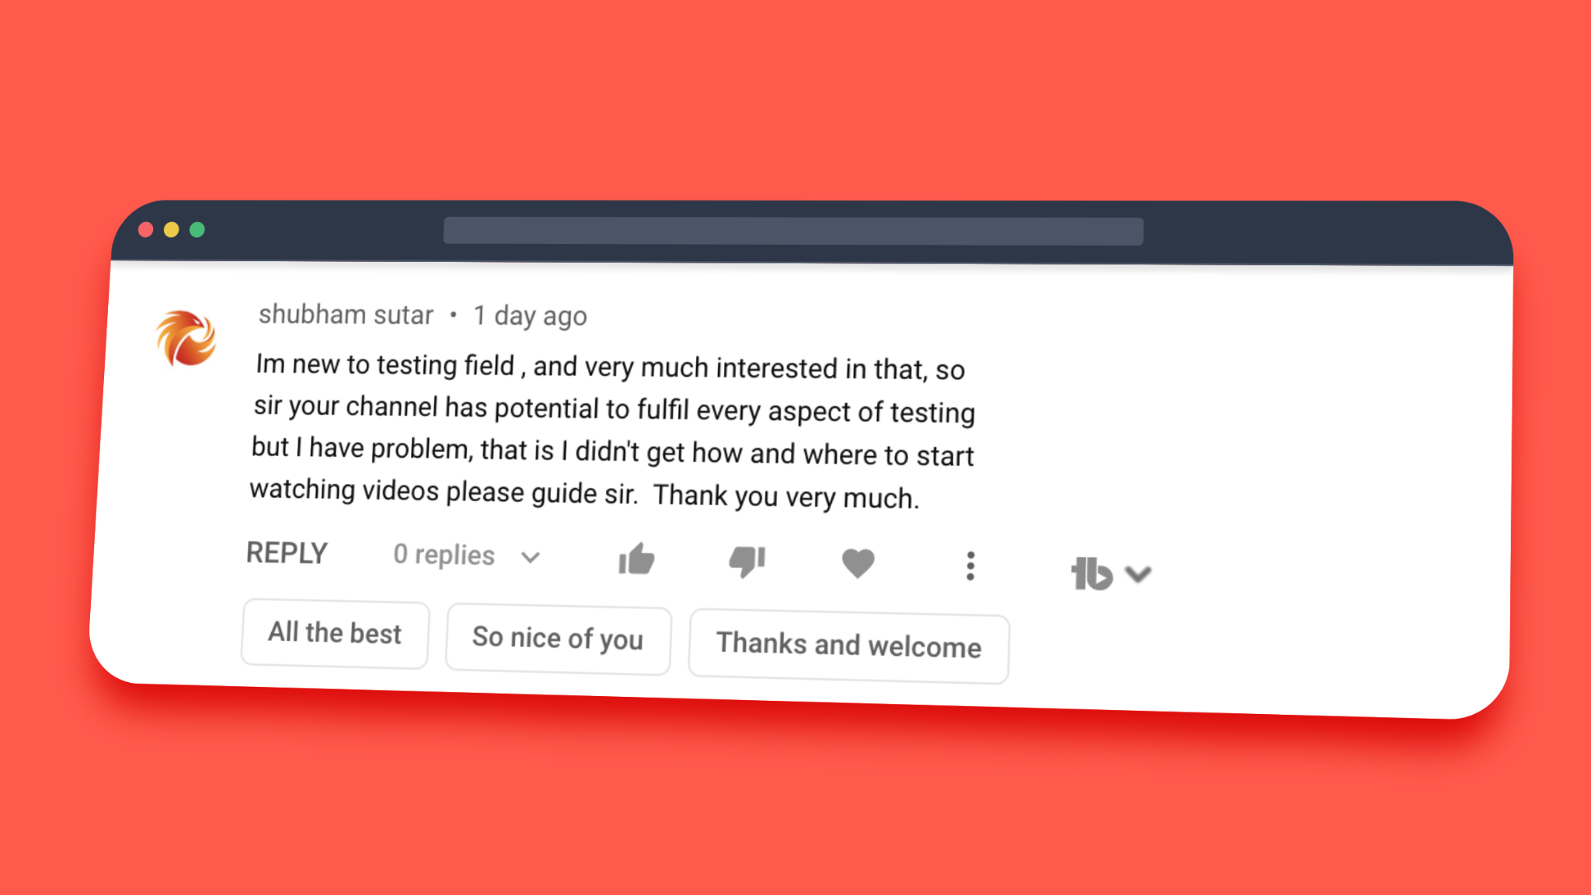
Watch - https://sdet.live/switch

Slide 6
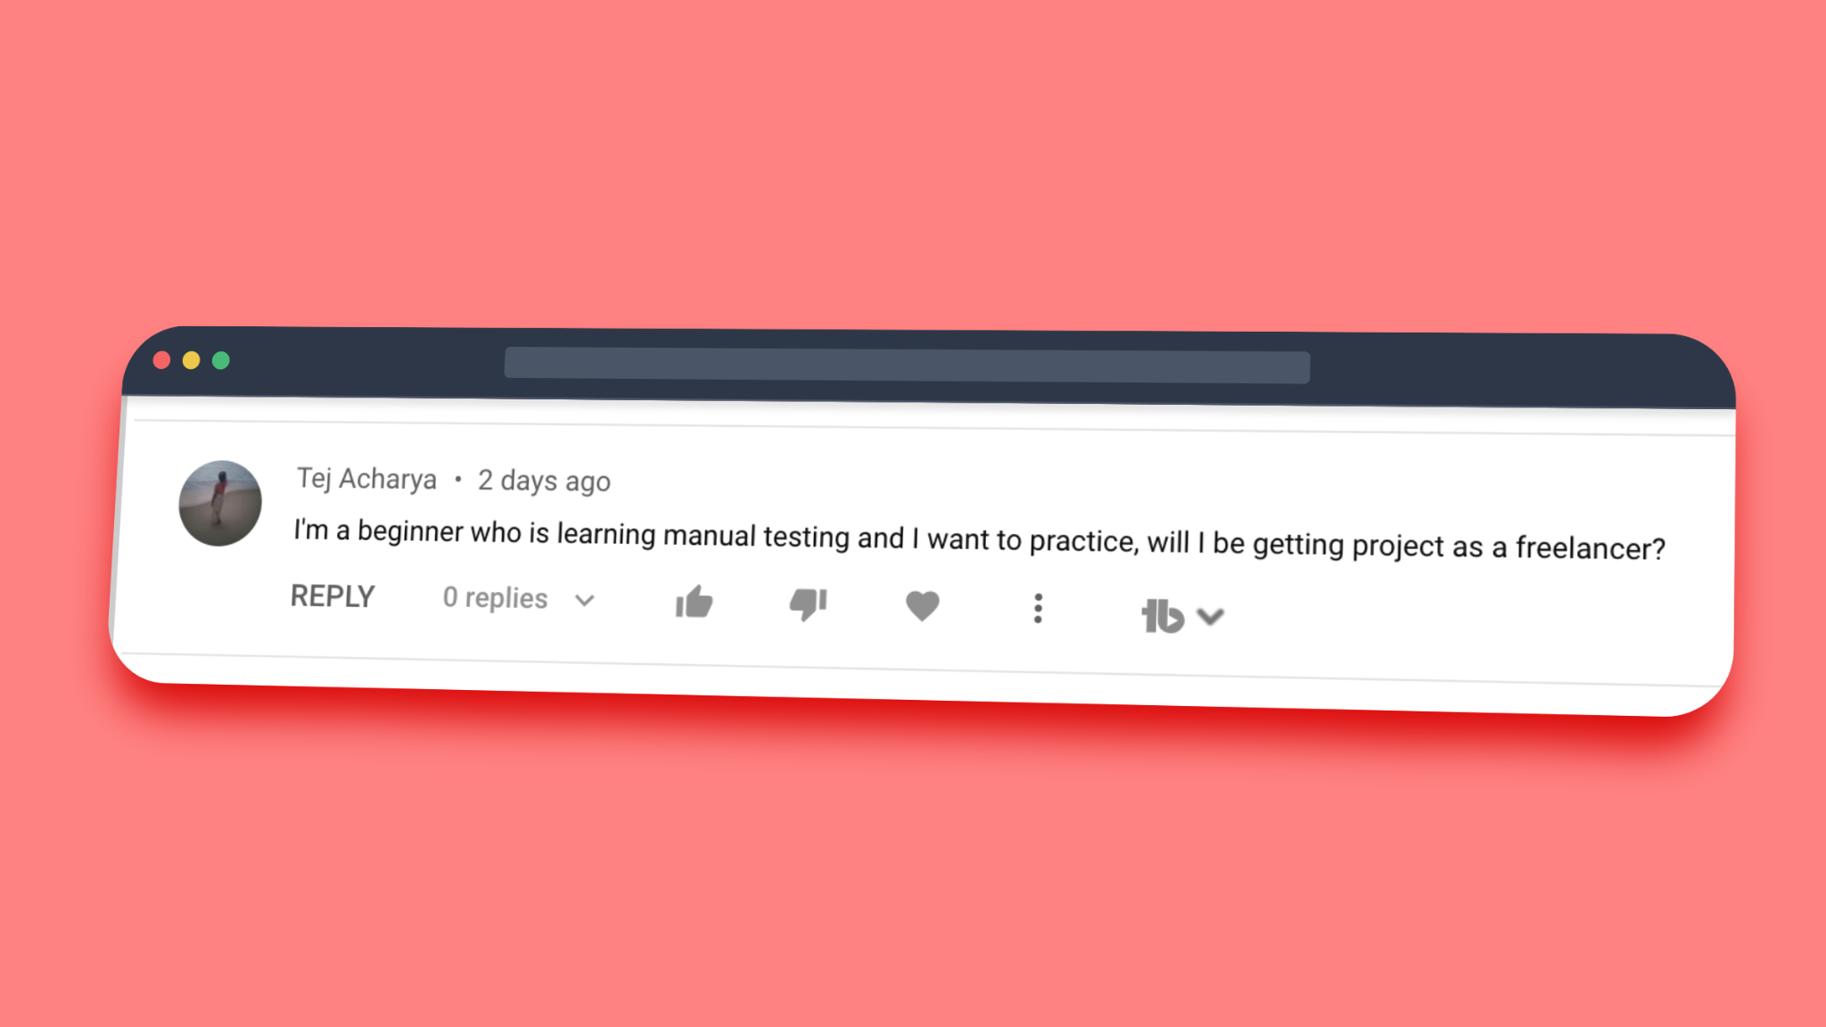
Watch - https://sdet.live/switch

Slide 7
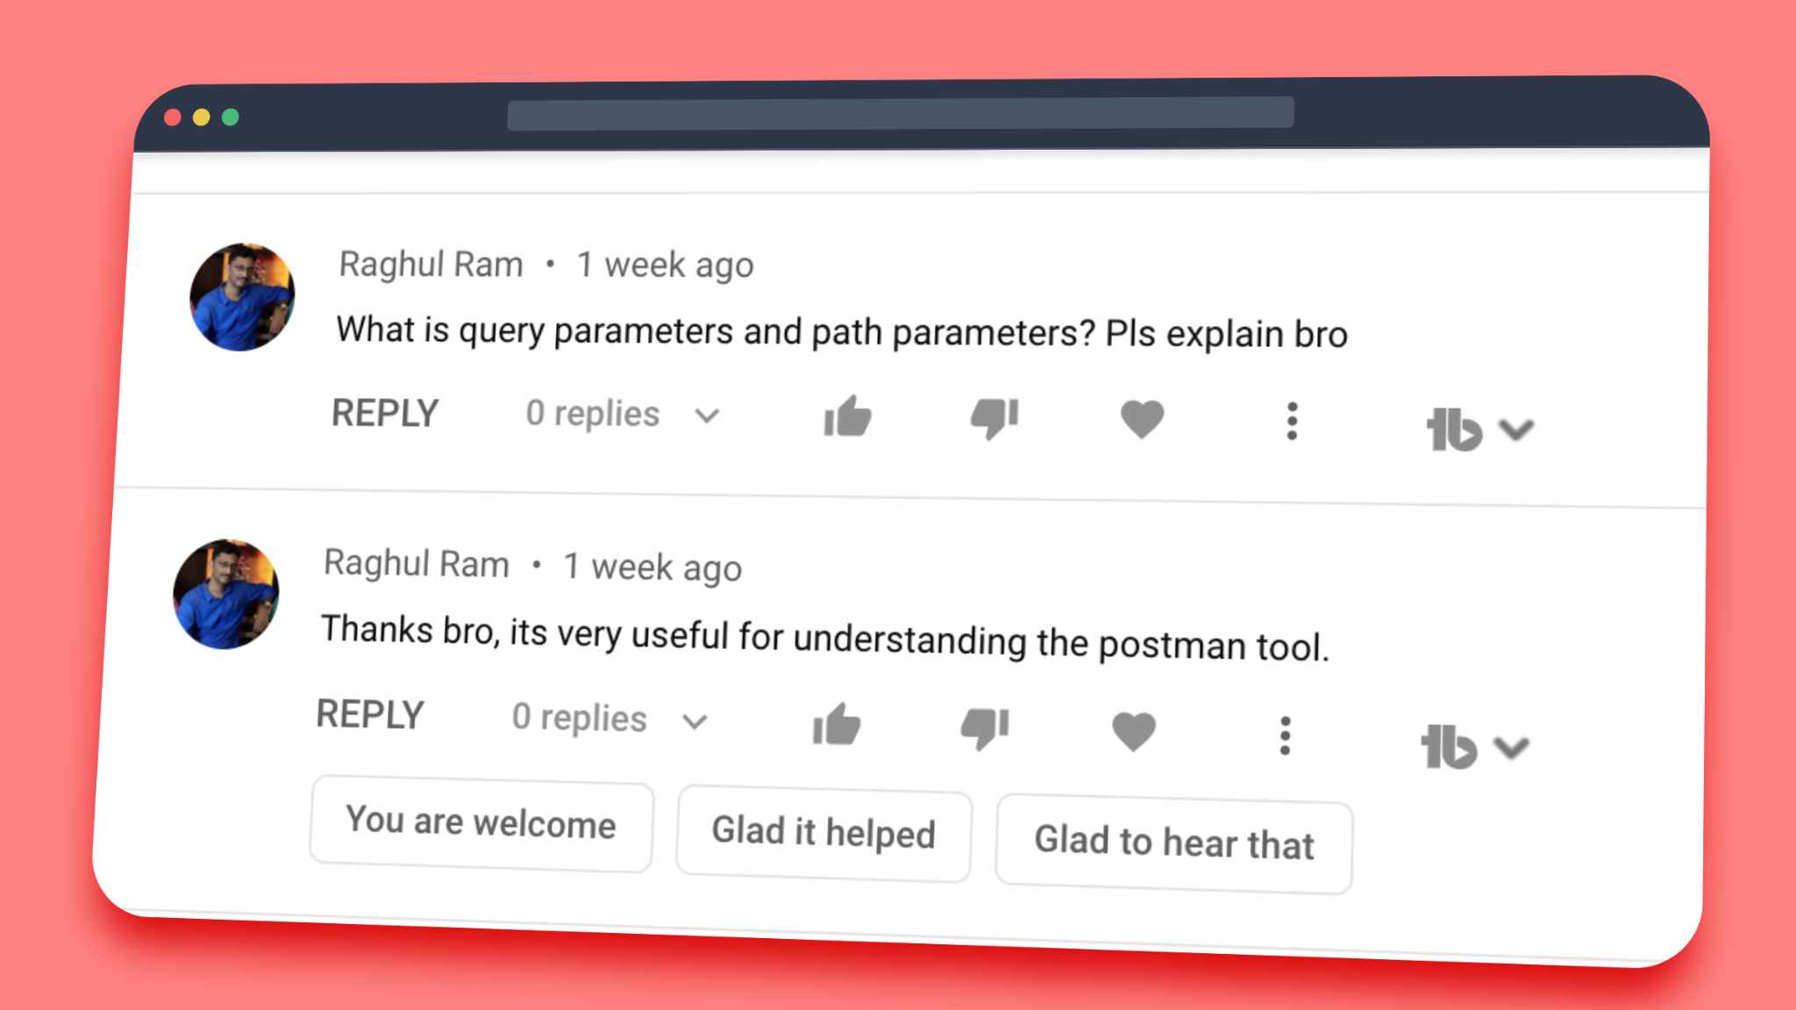
Watch - https://sdet.live/switch

Slide 8
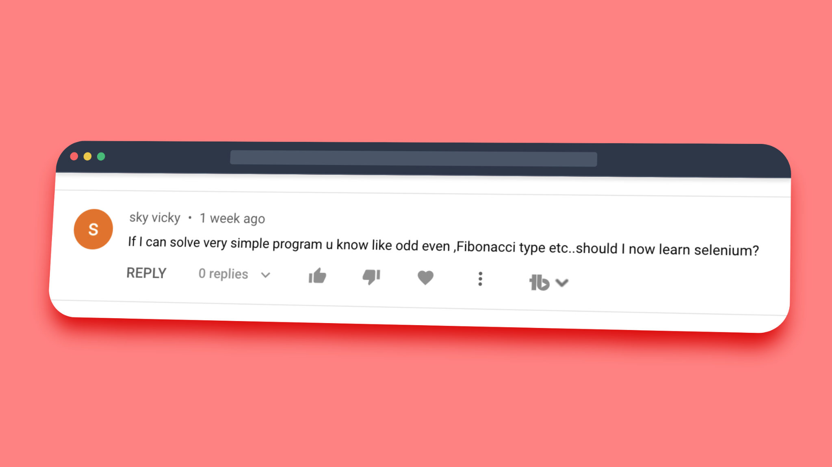
Watch - https://sdet.live/switch

Slide 9
Watch - https://sdet.live/switch

Slide 10
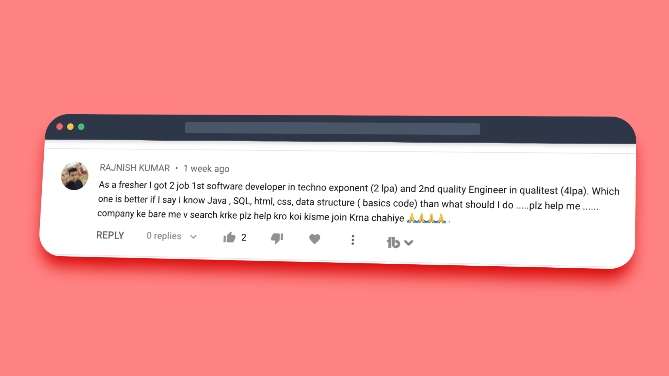
Watch - https://sdet.live/switch

Slide 11
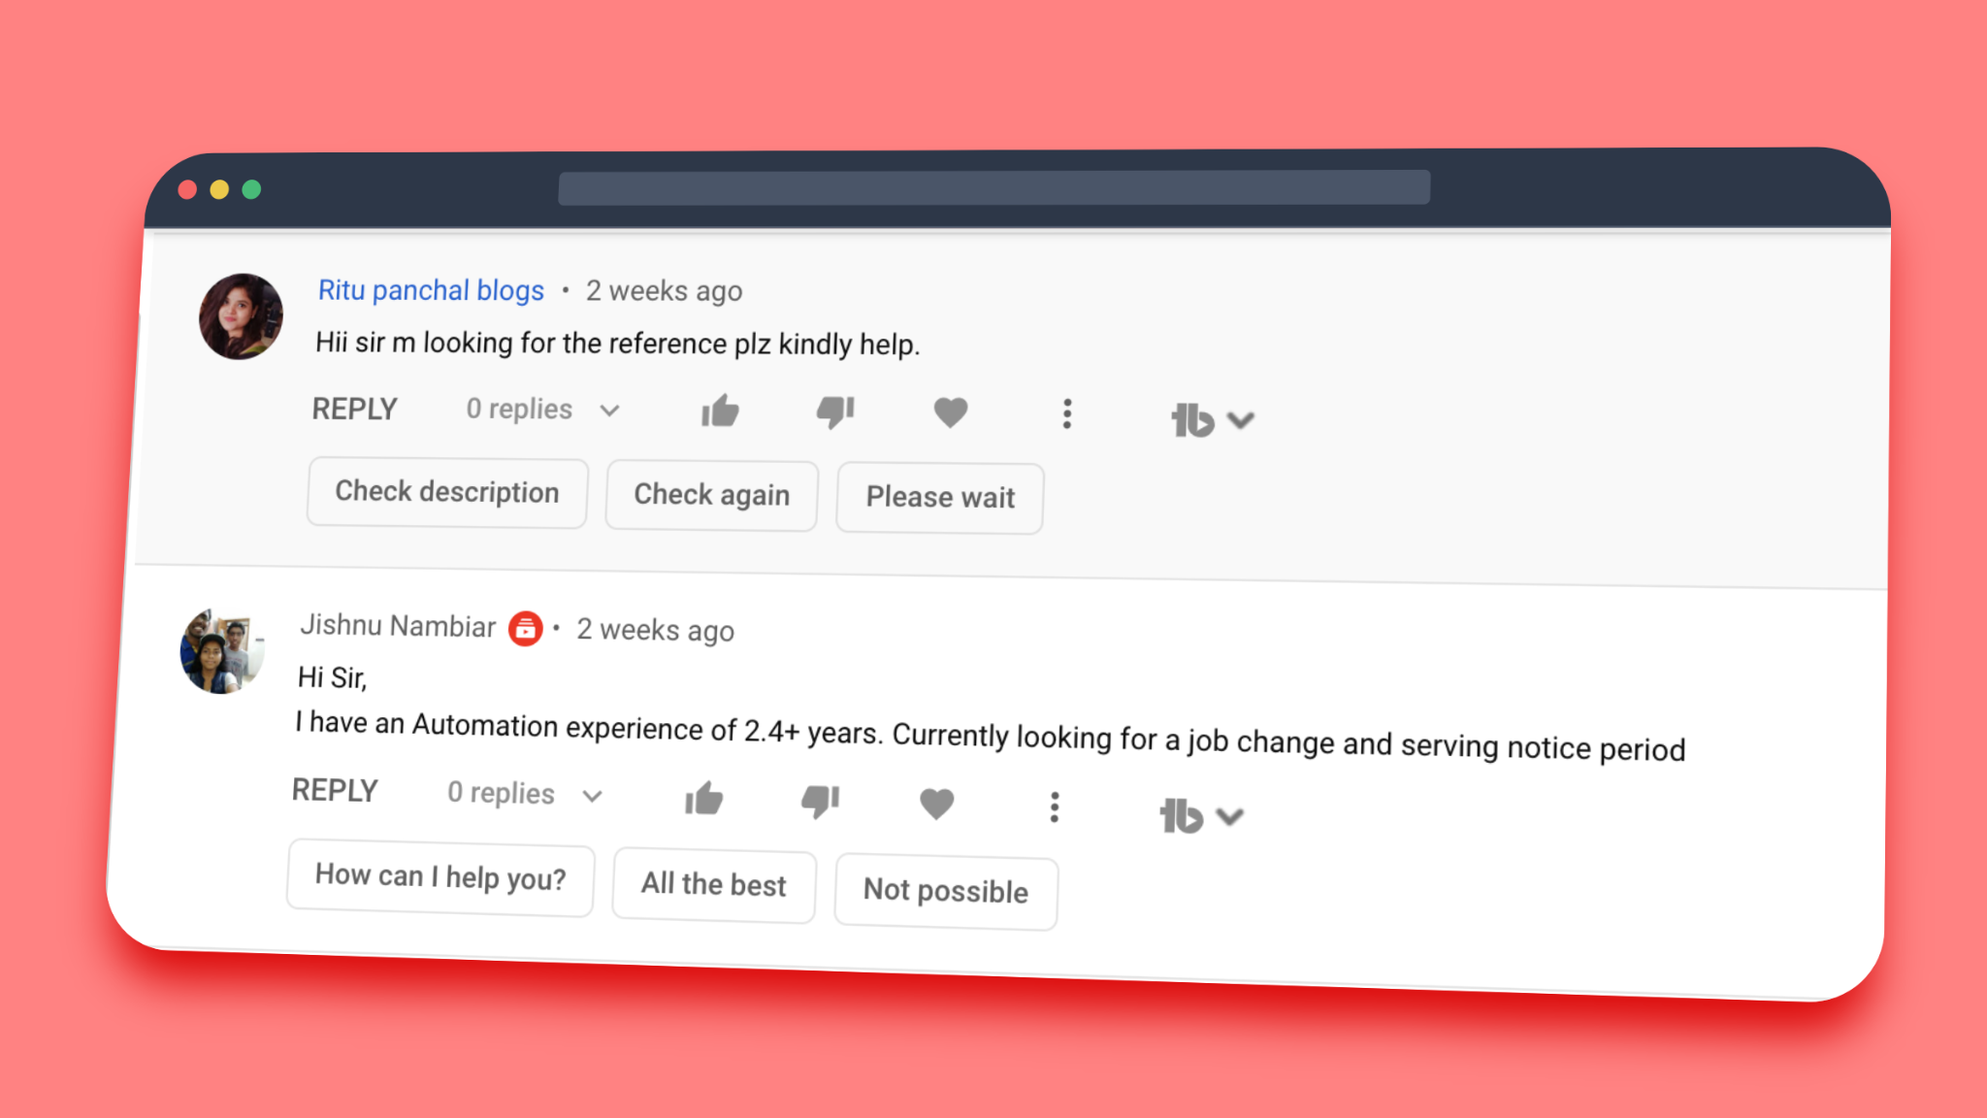
Email Resume at contact@thetestingacademy.com
Watch - https://sdet.live/switch
Subject - Name - Exp - Current Company - Automation /Manual

Slide 12
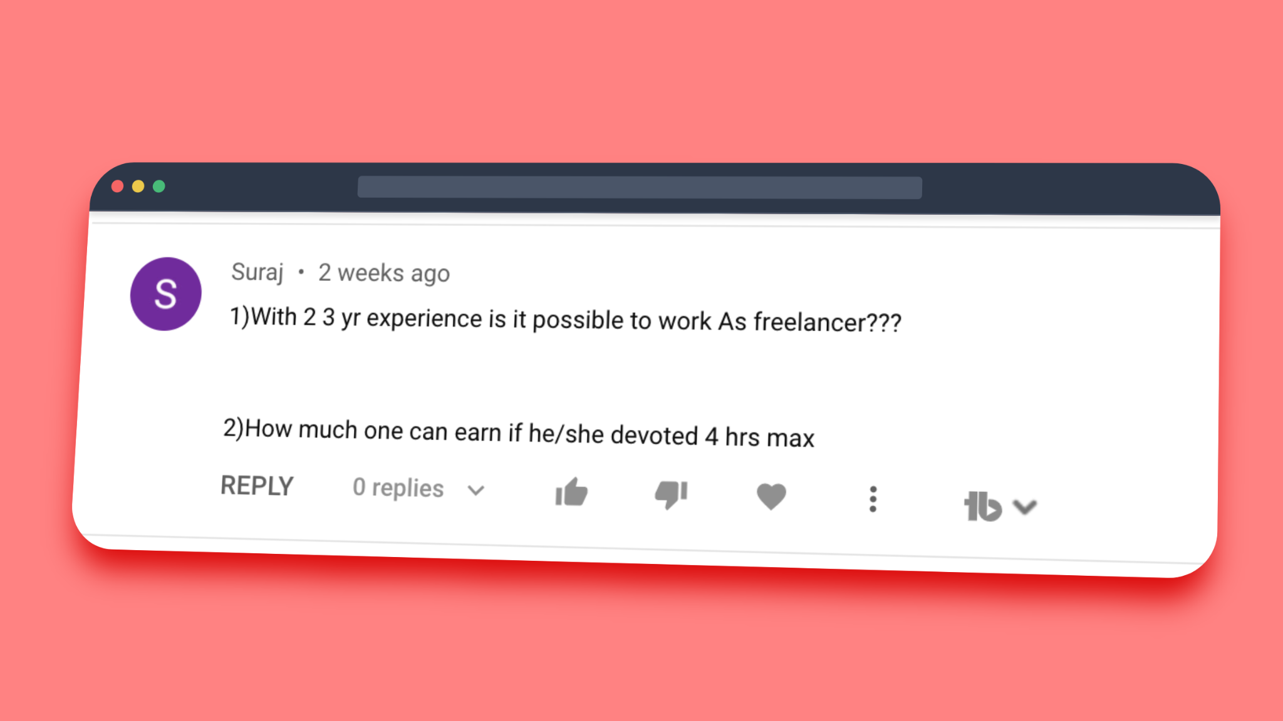
Email Resume at contact@thetestingacademy.com
Watch - https://sdet.live/switch
Subject - Name - Exp - Current Company - Automation /Manual

